Slide 1

Aligning Systems in MTSS:
How can we integrate supports within MTSS?
MTSS Forum | December 10, 2024
Catherine Bradshaw, Ph.D. & Erin ChAPARRO, PH.D.
cpb8g@virginia.edu & echaparr@uoregon.edu

Slide 2


Framing
  Core Features
  MTSS is rooted in Implementation Science Practice
  Data to Inform Discussion
  Examples of Systems Alignment
  Big Ideas and Resources
  MTSS is an Implementation Optimization Framework
1
2
3
Notes:
Overview of core features related to topic
Share data to frame the conversation
Big idea(s) about needed actions to inform
Policy,
Research, and/or
TA
Resources to inform next actionably steps for policy, research, and/or TA
Take away message
Big question to frame the table conversation

Slide 3
Core Features
1
  MTSS is Rooted in Implementation Science Practice
“We found guidance and materials from the National Implementation Research Network (NIRN; Fixsen et al., 2005) to be of special value for development of our implementation model,” Sugai & Horner, 2020. (See also Kincaid & Horner, 2017; Horner, Sugai, & Fixsen, 2017)

Slide 4
  MTSS is rooted in implementation science practice
1
What’s a framework?
For example, “schools are expected to have leadership teams that guide implementation of these practices, and a data system that allows measurement of both the fidelity with which practices are used and the level of student outcomes. While elements such as a set of behavioral expectations that will be defined and taught in each school are stipulated, PBIS does not dictate what those specific expectations should be, or how they are taught,” (Horner, Sugai, & Fixsen, 2017)
Notes:
This notion can combat many of the misunderstandings about MTSS

Slide 5
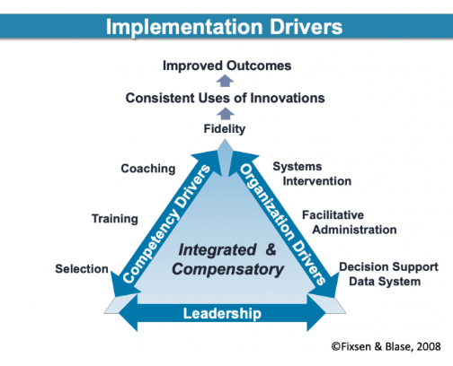
Implementation Science Practice
Active Implementation Frameworks -
Implementation Drivers

Slide 6
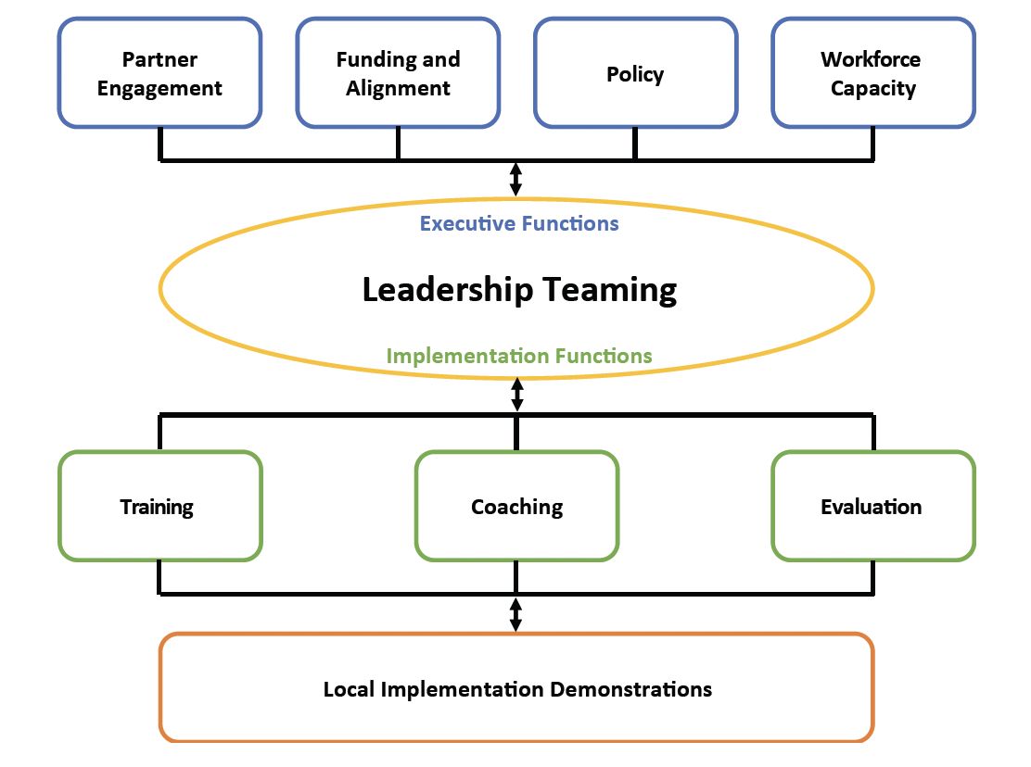
Implementation Drivers
PBIS District Practice Guide, 2024

Slide 7
  Leadership Team Functions:
  Systems Implementation & Integration Across Contexts (PBIS District Practice Guide, 2024)
Notes:
As Fixsen et al. (2019) stated, “Populations benefit when effective innovations are supported by effective implementation in enabling contexts that facilitate their use on a socially significant scale” (p. 1).

Slide 8
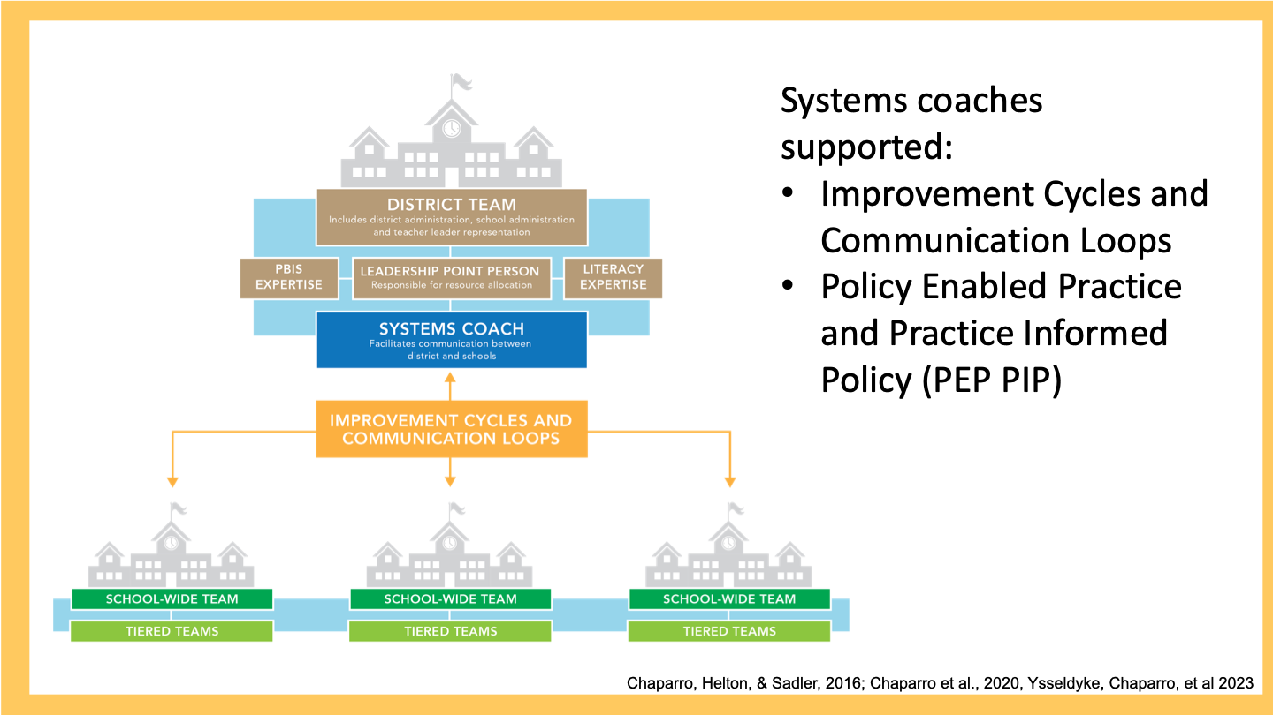
Teaming Structures with Systems Coaching
Notes:
Coaching is an essential implementation driver and strategy to facilitate systems alignment

Slide 9




Systems alignment occurs through facilitation from Systems Coaches
& intentional plan to integrate & differentiate professional learning & instructional coaching
District-level action planning
Select staff to provide training and coaching within the district
Create a plan to support a local Trainer/Coach Network
Utilize data to guide PD & Coaching plan
Adapted from L. Powers presentation at the 2024 PBIS Leadership Forum
Notes:
Coaching is an essential implementation driver and strategy to facilitate systems alignment

Slide 10
  Systems Alignment Facilitates the Prevention of EBP Abandonment

Slide 11
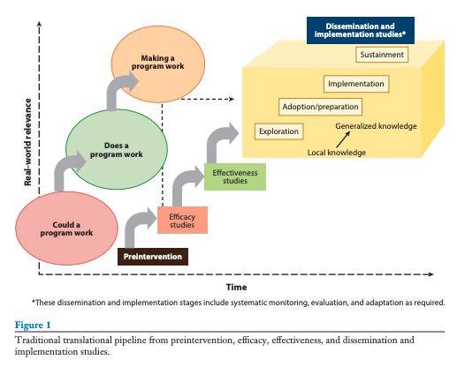
Traditional translational pipeline
Brown et al. (2017)
Notes:
The Active Implementation Hub, AI Modules and AI Lessons are developed by the
State Implementation & Scaling-up of Evidence-based Practices Center (SISEP) and The National Implementation Research Network (NIRN)
located at The University of North Carolina at Chapel Hill’s FPG Child Development Institute.

Slide 12
Intentional Implementation
Abandonment - unintentional or unwilling ceasing of implementation activities in whole or part, due to overwhelm, lack of resources, contextual mismatch, a change in leadership, policy, teacher turnover, etc. (Nese et al., 2016)
Education scientists just beginning to explore de-adoption of practitioner-level practices and curricula (Barrett et al., 2021; Farquharson et al., 2023)
De-implementation - the intentional removal of an innovation in the full implementation stage (Chaparro & McIntosh, 2025)
Notes:
Prevent abandonment of valued practices by facilitating drivers, determinants, and implementation strategies such as funding, leadership, coaching and training (Carnine, 1997; Han & Weiss, 2005; Herman et al., 2021; McIntosh et al., 2016)

Slide 13
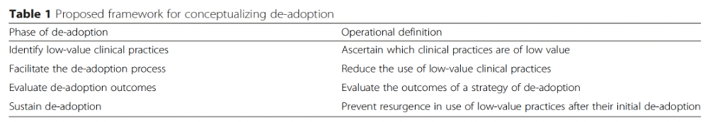
Intentional Exploration of De-Implementation
Hypothesis: We can improve implementation by identifying procedures for de-implementation of low-value practices and initiatives
Niven et al. (2015). Towards understanding the de-adoption of low-value clinical practices: a scoping review. BMC Medicine.

Slide 14
Big Ideas and Resources: Part 1
3
MTSS is an Implementation Optimization Framework

Slide 15

Need for Mental and Behavioral Health Supports in Schools
Signification portion of school-age youth experience a serious mental health issue, yet few receive services
  And those who do, are most likely to do so in schools
Situation is significantly exacerbated by COVID-19 pandemic
  40% increase in youth mental health concerns since the onset of the pandemic (Murthy, 2021; Racine, 2021)
    20% of adolescence are reporting depression symptoms
    25% of adolescence are reporting anxiety symptoms
    50% increase in suicide attempts (Yard et al., 2021)
Notes:
Can add this information verbally: Rural communities geographic isolation and scarce resources has resulted in limited mental health service options for rural youth and their families.

Slide 16
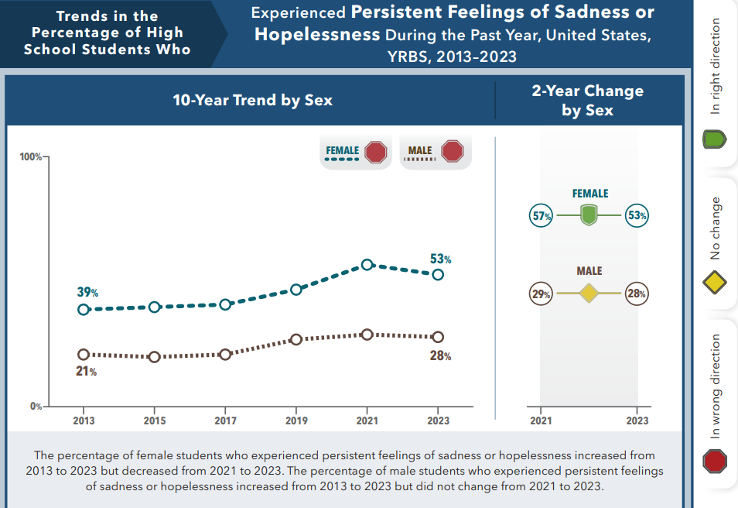
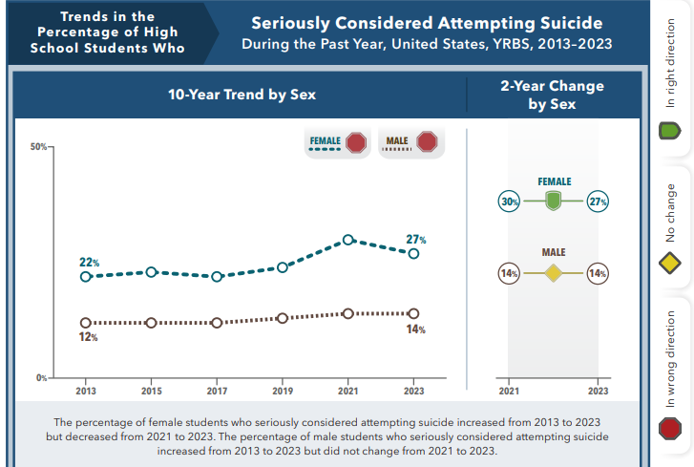
(CDC, YRBS data, 2024)

Slide 17
Factors Contributing to Increases in Youth Internalizing Mental Health Problems
(e.g., depression, anxiety, suicide attempts)
Increases in social media use
Cyberbullying
Declines in sleep
Opioid epidemic
Rising youth concerns over school violence and school shootings
COVID-19 Pandemic
(American Psychological Association, 2023; Cataldo et al., 2021; National Academies of Sciences, Engineering, and Medicine, 2019; 2022; Riehm et al., 2021; Twenge et al., 2019)

Slide 18
A Multi-tiered System of Supports:
A Public Health Approach to Prevention
Rethinking the proportions in the peri-COVID era? (Weist et al., 2024)
Indicated or Intensive Intervention
Individualized, functional
assessment, highly
specific for few
(Tier 3)
Universal Prevention
All students,
preventive, proactive
(Tier 1)
Selective or Targeted
Intervention
Some students,
reduce risk
(Tier 2)
(PBIS.org; Horner et al., 2009; IOM, 1997; NAS, 2009, 2019; Sugai & Horner, 1994; Walker et al., 1996)
Students within Schools
Notes:
18

Slide 19
Implementation Science Framework
An operating system for your school!
Helps you implement other programs better!
OUTCOMES
SYSTEMS
DATA
PRACTICES
(Horner & Sugai, 2001; Lewis & Sugai, 1999; Sugai & Horner, 2006; www.PBIS.org; Bradshaw, 2023)

Slide 20
Impacts of Multi-tiered System of Supports for Behavior
Student Outcomes
  Reduces bullying, suspensions, aggressive behavior, unnecessary referrals to special education, & discipline problems, particularly among higher-risk students
  Improves emotion regulation, concentration, prosocial behavior, & academic achievement
Staff Outcomes
  Improves school climate, principal leadership, collegial relationships, classroom conditions for learning, student engagement, & academic emphasis
(PBIS.org; Bradshaw et al., 2009, 2021, 2020; Horner et al., 2009; Lee & Gage, 2020; IES, 2022)

Slide 21
Synergistic Effects
Climate
Connectedness
Disclosure
(Cornell et al., 2016)

Slide 22
Impacts of Multi-tiered System of Supports for Behavior (cont)
Lessons Learned from Leading 4 Randomized Controlled Trials of PBIS/MTSS-B
  Get a lot of benefit from the universal (Tier 1) supports, particularly among higher-risk students
  Need coaching and to focus on implementation to reach high fidelity and optimize outcomes
  Requires district and state support to ensure high fidelity implementation
  Synergistic effect when combined with social and emotional learning
  Helps to optimize implementation and integration with other evidence-based programs – like an “operating system” for your school
(PBIS.org; Bradshaw et al., 2009, 2020, 2021; Lindstrom Johnson et al., 2024; Bradshaw et al., in preparation)

Slide 23

Financial Savings
Significant Return on Investment of Tier 1 Supports
  Net total present-day cost savings value of $450,000 per 100 elementary students and $86,000 for every 100 secondary students
    taking in consideration student outcomes of MTSS/PBIS on academics, bullying, aggressive behavior, suspensions, mental health (Bradshaw et al., 2020; 2021, 2023)
https://ruralsmh.com/cost-calculator/

Slide 24




Integrating Other EBPs within the MTSS Framework
  Social-emotional learning programs (Bradshaw, Ialongo, Lochman, Tolan: 3 RCTs IES)
  Bullying and aggression prevention (Pas/Waasdorp PIs: R01 NICHD)
  Coaching in culturally-responsive student engagement (Bradshaw PI: IES 3 RCTs; NIMHD R01)
  Mental health screening and tele-ECHO (Lyons PI: NIMH R01)
  Early Identification System (Reinke PI: IES Rural Center)
https://doublecheckcoaching.org/
Evidence-Informed Mental health Prevention, Assessment, Collaboration, & Treatment in Middle Schools
https://www.ruralsmh.com

Slide 25
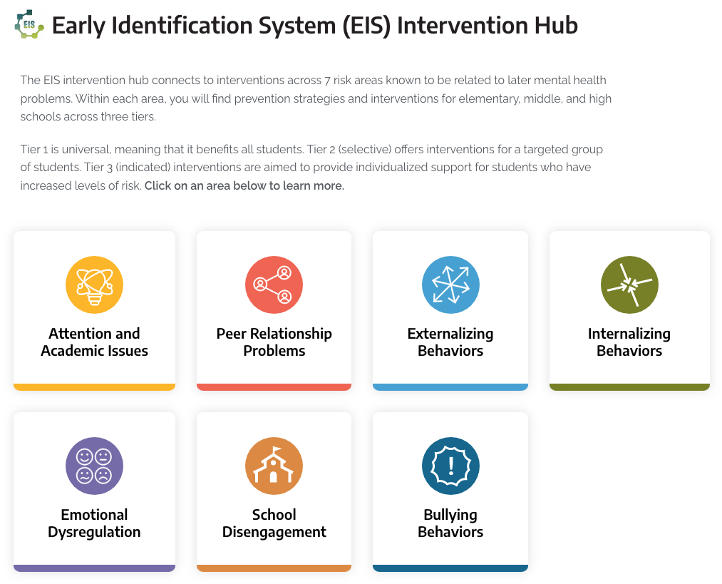
Early Identification System (EIS)
NIMH: 1RF1MH132345-01 (PI: Mike Lyons)
Evidence-Informed Mental health Prevention, Assessment, Collaboration, and Treatment in Middle Schools (E-IMPACTS)
  The EIS is an online screener that helps schools screen students for mental or behavioral health needs
  Validated instrument
  Based on results, the EIS provides recommendations for evidence-based supports (Reinke et al., 2021)

Slide 26
Big Ideas and Resources: Part 2
3
MTSS Can Help Us Address
Growing Workforce Concerns

Slide 27
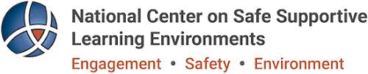
Connection Between Educator Well-being and Mental Health
Educator well-being influences how staff feel:
Day to day
About their ability to do
their job
About their overall physical and mental health
Twice as many educators—compared to the general population of working adults — are likely to report experiencing job-related stress, are burnt out, and feel less resilient to cope with job-related stress (Steiner et al, 2022).
27% of educators reported symptoms of clinical depression (Center for Disease Control Foundation (CDC), 2021).
37% of educators reported symptoms of having anxiety (CDC, 2021).
Steiner, E.D., Doan, S., Woo, A., Gittens, A.D., Lawrence, R.A., Berdie, L., Wolfe, R.L., Greer, L., & Schwartz, H.L. (2022). Restoring teacher and principal well-being Is an essential step for rebuilding schools: Findings from the State of the American Teacher and State of the American Principal Surveys. Santa Monica, CA: RAND Corporation.; CDC Foundation (2021). Mental health impact of the COVID-10 pandemic on teachers and parents of K-12 students.

Slide 28
Insights on Educator Well-being and Recruitment and Retention
Staff
Wellbeing
Recruitment & Retention
Equity
Creating a positive school culture, in which educators feel valued and have a sense of well-being, is essential for attracting and retaining high-quality educators.
PBIS Tier 1 Staff Outcomes
  Improves school climate, principal leadership, collegial relationships, classroom conditions for learning, student engagement, & academic emphasis

Slide 29
Teacher Outcomes Important to Consider
Interactions between Classroom Context and Outcomes for Students and Teachers
  Good Behavior Game/My Teaching Pattern RCT for Early-Career Teachers:
    Those teachers in classrooms which were more challenged had the most improvements – those effects persisted through COVID on outcomes like burnout and efficacy (Tolan et al., 2020; Downer et al., 2024; Budavari et al., in press)
  Interaction between classroom context and Double Check outcomes (Debnam et al., 2024)
Important Outcomes on for Teachers on Burnout, Efficacy, Wellbeing, and Organizational Health
  Double Check (Bradshaw et al., 2018, Debnam et al., 2024)
  PATHS to PAX/GBG: Domitrovich, Bradshaw et al., 2016)
  CARE Model: (Jennings et al. 2019)

Slide 30
Big Ideas and Key Takeaways
MTSS is rooted in implementation science practice
  Systems coaching as an implementation driver and strategy to facilitate systems alignment
Systems alignment facilitates the prevention of EBP abandonment
    Explore and enhance de-implementation to improve implementation
MTSS has the potential to optimize implementation of other EBPs
  Helps school implement other programs and practices better
MTSS can help us address growing workforce needs, and improve organizational health and wellness
  Improved the working conditions and supporting educators will be critical for increasing academic performance and implementation of high fidelity social and behavioral programming

Slide 31

Resources & References
Implementation Science Research Learning Modules https://smartcenter.uw.edu/programs-services/riise/
National Center on Safe Supportive Learning Environments (NCSSLE) https://safesupportivelearning.ed.gov
  NCSSLE Working Well Resource Directory
Bradshaw, C.P., Budavari, A.C., Nguyen, A., Henderson Smith, L., Beahm, L., Pandey, T., & Pas, E.T. (2024). Integrating social and emotional learning and multi-tiered systems of support for behavior: A strategy for optimizing implementation and scale-up of SEL programming. Handbook of Social and Emotional Learning (2nd Ed.): Guilford Press.
Bradshaw, C.P. (2023). Leveraging implementation science to improve the scale-up of school mental health programming. In S. Evans, J. Owens, C.P. Bradshaw, & M.D. Weist (Eds.). Handbook of School Mental Health: Innovations in Science and Practice (third edition). New York: Springer.
Chaparro, E. A. & McIntosh, K. (2025). Using Implementation Science to Bridge the Gap between Research and Practice in Positive Behavior Support and Positive Behavioral Interventions and Supports. In Lewis, T., Simonsen, B., George,. H. & McIntosh, K. (Eds.). Handbook of Positive Behavior Supports (second edition).
Chaparro, E. A., Massar, M. M., & Blakely, A. W. (2021). Exploring the Knowledge and Skills of Systems-Level Coaches within Elementary Schools Implementing Multitiered Systems of Support. The Elementary School Journal, 122(2), 191–207. https://doi.org/10.1086/716909

Slide 32

Discussing
How can we leverage technology to facilitate systems systems alignment, high quality implementation and scale-up?
:
Scan to access MTSS resources to support your discussion
Notes:
Overview of core features related to topic
Share data to frame the conversation
Big idea(s) about needed actions to inform
Policy,
Research, and/or
TA
Resources to inform next actionably steps for policy, research, and/or TA
Take away message
Big question to frame the table conversation

