Slide 1
MTSS-SEB/MH:
How do we support students’ Social-Emotional-Behavioral and Mental Health needs in MTSS?
MTSS Forum | December 10, 2024
Nikole Hollins-sims & Kent McIntosh
dr.nikolehsims@gmail.com kentm@uoregon.edu

Slide 2


Framing
  Core Features
  Systems
  Data
  Practices
  Centered in Equity
  Data to Inform Discussion
  Widespread Use of PBIS
  Economic Benefit
  Research on Implementation and Sustainability
  Integrated MTSS-SEB/BH Outcomes
  Big Ideas and Resources
  Improving Social-Emotional Behavioral Wellness Supports within MTSS
  Centering Equity
1
2
3
Notes:
Overview of core features related to topic
Share data to frame the conversation
Big idea(s) about needed actions to inform
Policy,
Research, and/or
TA
Resources to inform next actionably steps for policy, research, and/or TA
Take away message
Big question to frame the table conversation

Slide 3
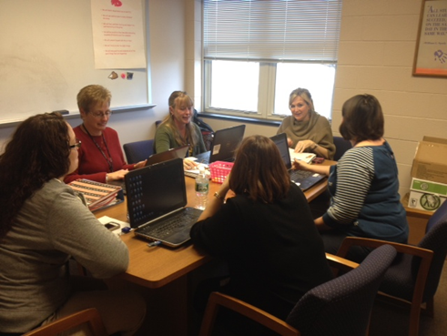
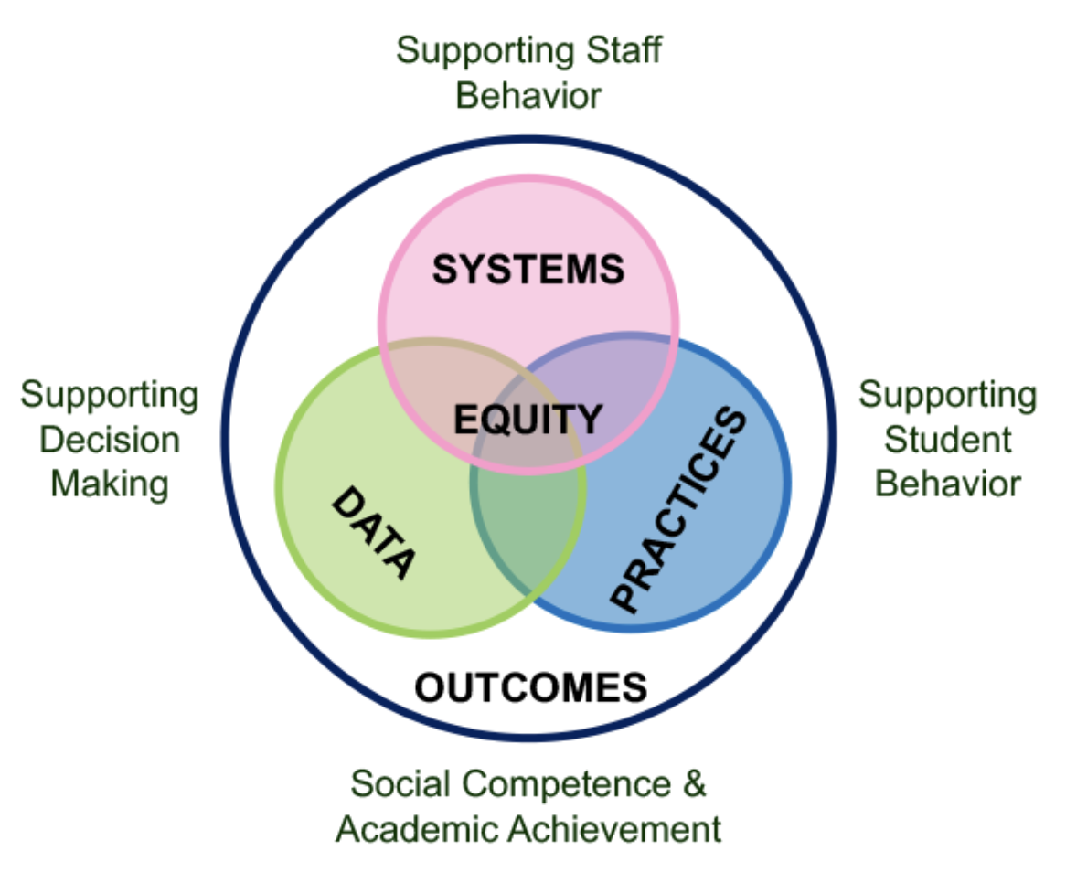
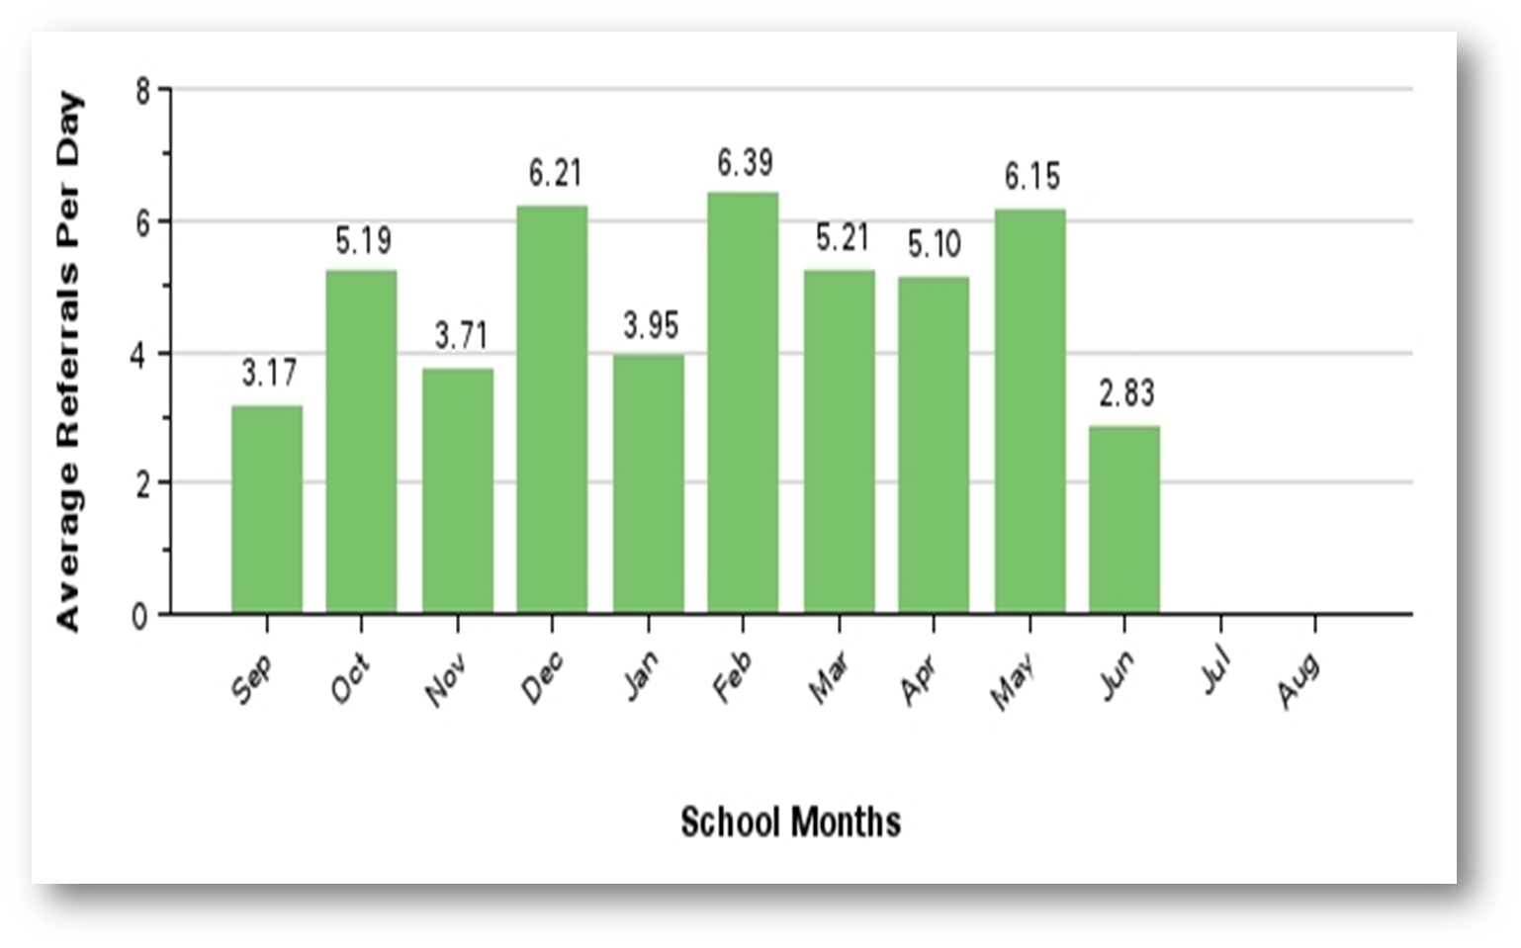

Core Features
1
5
PBIS
Elements

Slide 4
Data to Inform Discussion
2
DATA

Slide 5
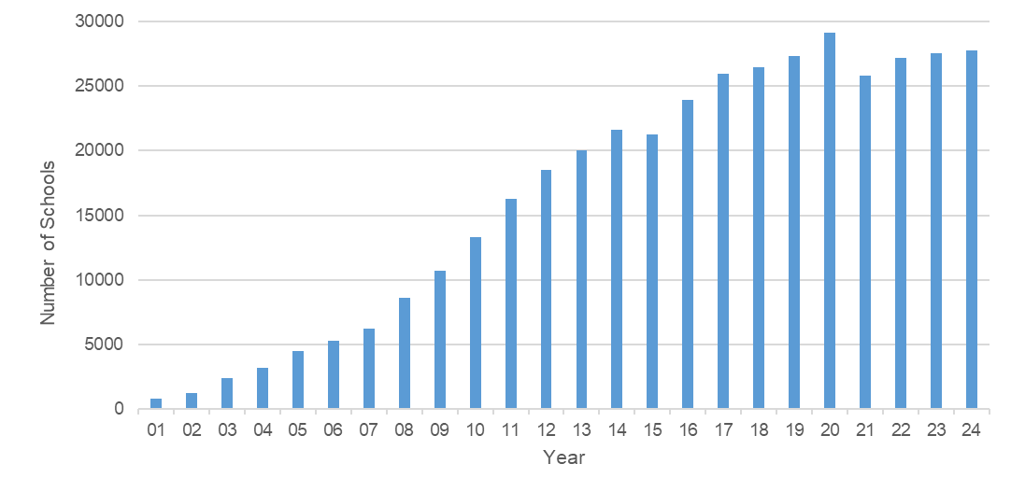

U.S. Schools Using PBIS
August 2024
27,759
Notes:
# of schools (a) trained by the Center on PBIS or its affiliated state networks, (b) with active PBIS leadership teams, and (c) with a current action plan (reported by state PBIS teams, or # of schools that submitted implementation or outcomes data to the Center on PBIS via PBISApps if there are no data reported).
For comparison, the total # of US Schools is 97,632 (from NCES data 2017-18)

Slide 6
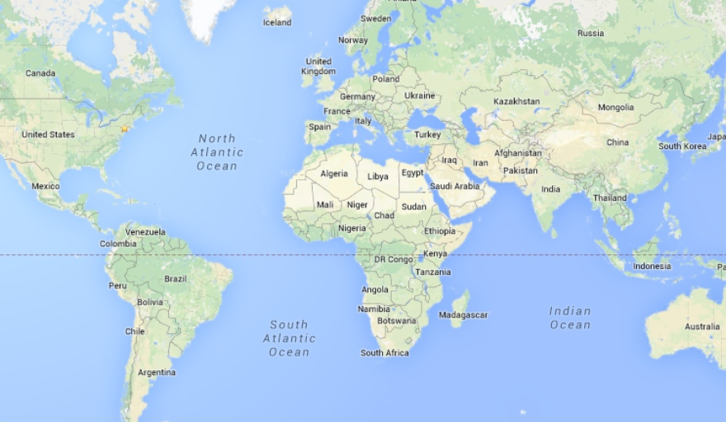

PBIS Around the World
Notes:
Over 35 countries
Over 20 in Europe (PBS Europe Network)

Slide 7
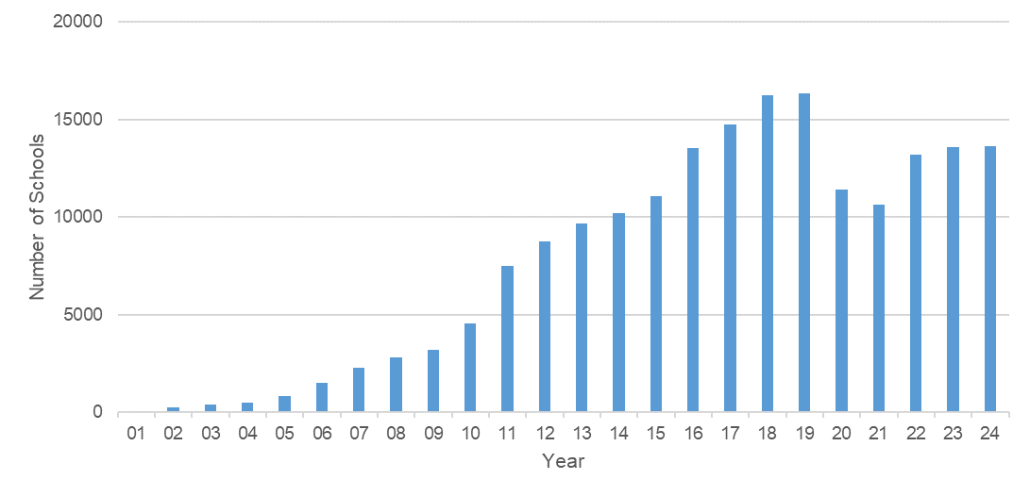
U.S. Schools Reporting PBIS Fidelity
August 2024
13,617
Notes:
Number of unique schools submitting scores from at least one validated Center on PBIS fidelity of implementation measure to the Center (primarily through PBIS Assessment, with a few reporting in their state systems and then sharing with the Center).
2022-23: 13,484

Slide 8
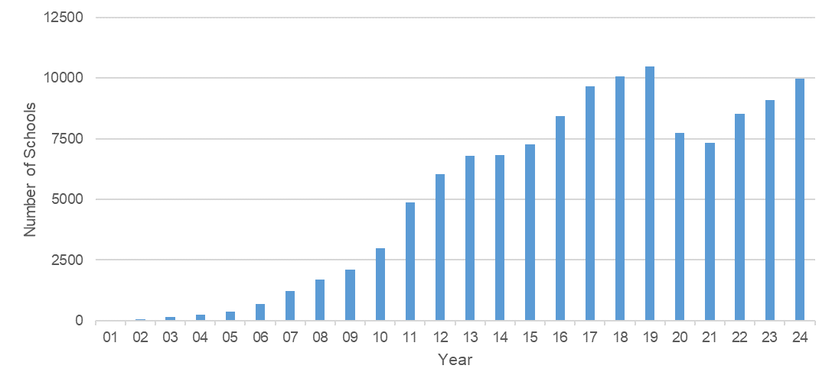
U.S. Schools Implementing Tier 1 PBIS at Fidelity
August 2024
73% of Schools
Notes:
Number of unique schools implementing Tier 1 PBIS with fidelity through a validated Center on PBIS fidelity of implementation measure (e.g., TFI Tier 1 or BoQ 70%+, SET 80%+).

Slide 9
Statistically Significant Outcomes of PBIS https://www.pbis.org/resource/is-school-wide-positive-behavior-support-an-evidence-based-practice
Reduced
Improved
Use of exclusionary discipline
  (Bradshaw et al., 2010, 2021; Elrod et al., 2022; Flannery et al., 2014; Freeman et al., 2015; Gage et al., 2018; Grasley-Boy et al., 2022; Horner et al., 2005; Metzler et al., 2001; Nelson, 1996; Nelson et al., 2002; Solomon et al., 2012)
Racial inequities in discipline
  (Fox et al., 2021; Gion et al., 2022; McIntosh et al., 2018; McIntosh et al., 2021a; McIntosh et al., 2021b; Muldrew & Miller, 2021; Payno-Simmons, 2021; Swain-Bradway et al., 2019)
Bullying and exclusion
  (Waasdorp et al., 2012)
Teacher burnout and stress
  (Kelm & McIntosh, 2012; Ross & Horner, 2006; Ross et al., 2012)
Prosocial behavior
  (Metzler, Biglan, Rusby, & Sprague, 2001; Nelson et al., 2002)
Emotional regulation
  (Bradshaw et al., 2012)
Academic achievement
  (Angus & Nelson, 2021; Horner et al., 2009; Lassen, Steele, & Sailor, 2006; Nelson et al., 2002)
Teacher-student relationships
  (Condliffe et al., 2022)
School climate and school safety
  (Elrod et al., 2022; Horner et al., 2009; Kubiszewski et al., 2023; McIntosh et al., 2021)
Organizational health
  (Bradshaw et al., 2008)

Slide 10
PBIS as a Wise Investment
(Swain-Bradway et al., 2017)
For every $1 spent implementing PBIS,
there are $105 in savings to improve school completion and reduce drop-out.
Brief: http://www.pbis.org

Slide 11

Impact Post-2020
Missouri Schoolwide Positive Behavior Support (MO SW-PBS)
Highlights:
  Schools with long-term implementation with fidelity/recognition (6+ years) demonstrated reduced exclusionary discipline (OSS) and chronic absenteeism.
  These outcomes were true for students in general education and those receiving special education services.
  Important to note - Across the country these outcomes were trending upward during the pandemic years.
  This example demonstrates the value of sustainable implementation with fidelity and able to withstand a major educational disruption.

Slide 12
3 Pressing Questions about MTSS-SEB/MH

Slide 13

Pressing Question 1:
What predicts sustained implementation of Tier 1 MTSS-SEB/MH?
Research reported here was supported by the Institute of Education Sciences, U.S. Department of Education, through Grant R324A120278 to the University of Oregon. The opinions expressed are those of the authors and do not represent views of the Institute, Office, or the U.S. Department of Education.

Slide 14
Predictors of Sustained Tier 1 Implementation
State
State Leadership
Teams
Centralized Training Systems
Standardized Training Curriculum
State Sys.
Fidelity
Inventory
District
District Training Systems
District Coaching Systems
Communities of Practice
District Sys. Fidelity Inventory
Maintain Model Sites for Visits
School
Effective and Efficient
Teaming
Data Collection and Use
Getting to Fidelity Quickly
Sharing Data with Whole Staff
Classroom MTSS Systems
Hume & McIntosh (2013), McIntosh et al. (2013, 2018, 2024), Hume & McIntosh (2013), McIntosh et al. (2015), Childs et al. (2016), Mathews et al. (2014), Hume & McIntosh (2013), Kittelman et al. (2023), McIntosh et al. (2013, 2018), McIntosh et al. (2016a), McIntosh et al. (2016b)

Slide 15
4 Research-Based Tips for Sustaining Tier 1 PBIS
Keep a strong PBIS team
Use your fidelity of implementation data
Use your school discipline data
Implement PBIS in the classroom
https://pbisapps.wistia.com/medias/uhkgj8pf29

Slide 16
Pressing Question 2:
What predicts sustained implementation of Tier 2 and 3 MTSS-SEB/MH?
Research reported here was supported by the Institute of Education Sciences, U.S. Department of Education, through Grant R324A1800027 to the University of Oregon. The opinions expressed are those of the authors and do not represent views of the Institute, Office, or the U.S. Department of Education.

Slide 17
Key Findings
Teams were more likely to sustain when they treated Tiers 2 and 3 as “general advanced tiers” rather than separate systems.
  Same teams
  Same data
  Same coaching
(Kittelman et al., in press)

Slide 18
Key Findings (part 2)
Teams were more likely to sustain Tier 2 systems when they delayed training until after they had reached fidelity at Tier 1.
Teams were more likely to sustain Tier 3 systems when they started training one year after they started training at Tier 2.
(Kittelman et al., 2022)

Slide 19
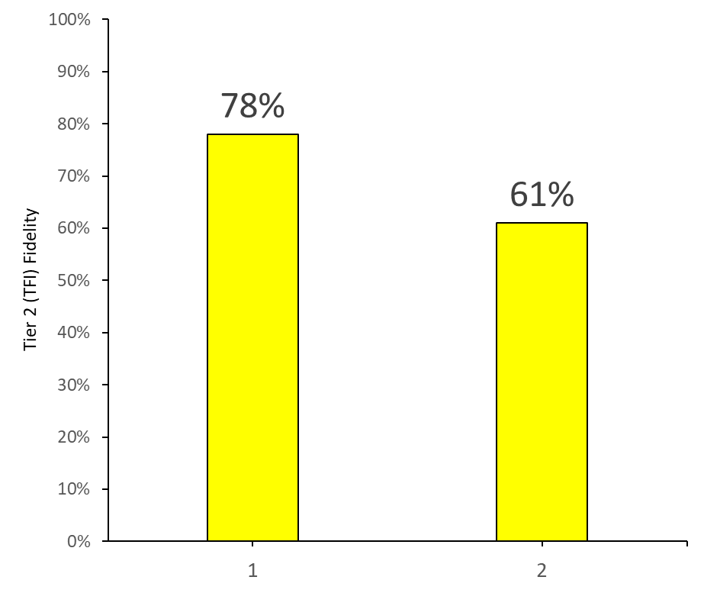
Key Findings (part 3)
Teams using a standard protocol (as opposed to problem solving) approach had higher fidelity at Tier 2.
(Nese et al., 2023)
Yes No

Slide 20
Pressing Question 3:
What are outcomes from integrated MTSS-SEB/MH?
Research reported here was supported by the Institute of Education Sciences, U.S. Department of Education, through Grants R324A170034 and R305A230399 to the University of Oregon. The opinions expressed are those of the authors and do not represent views of the Institute, Office, or the U.S. Department of Education.

Slide 21
MTSS
PBIS
School-based
Mental Health
Family
Partnerships
Restorative Practices
Equity
Student Voice
Social and
Emotional
Learning

Slide 22
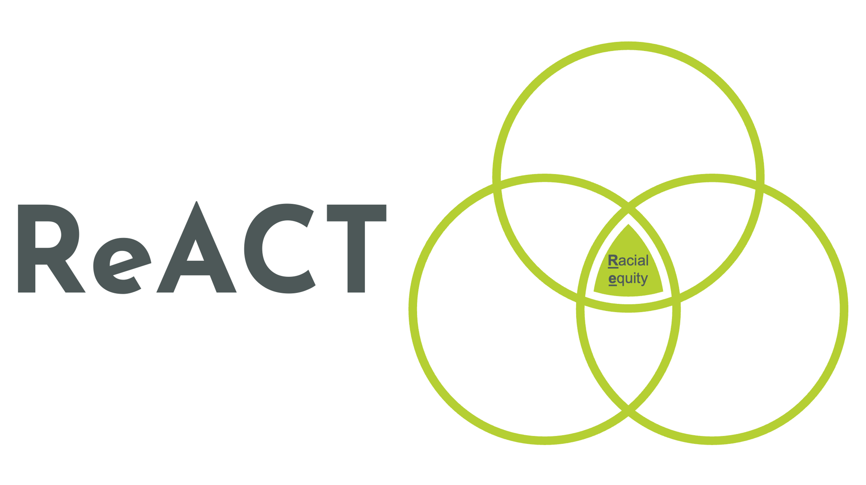
Project Re-ACT

Slide 23
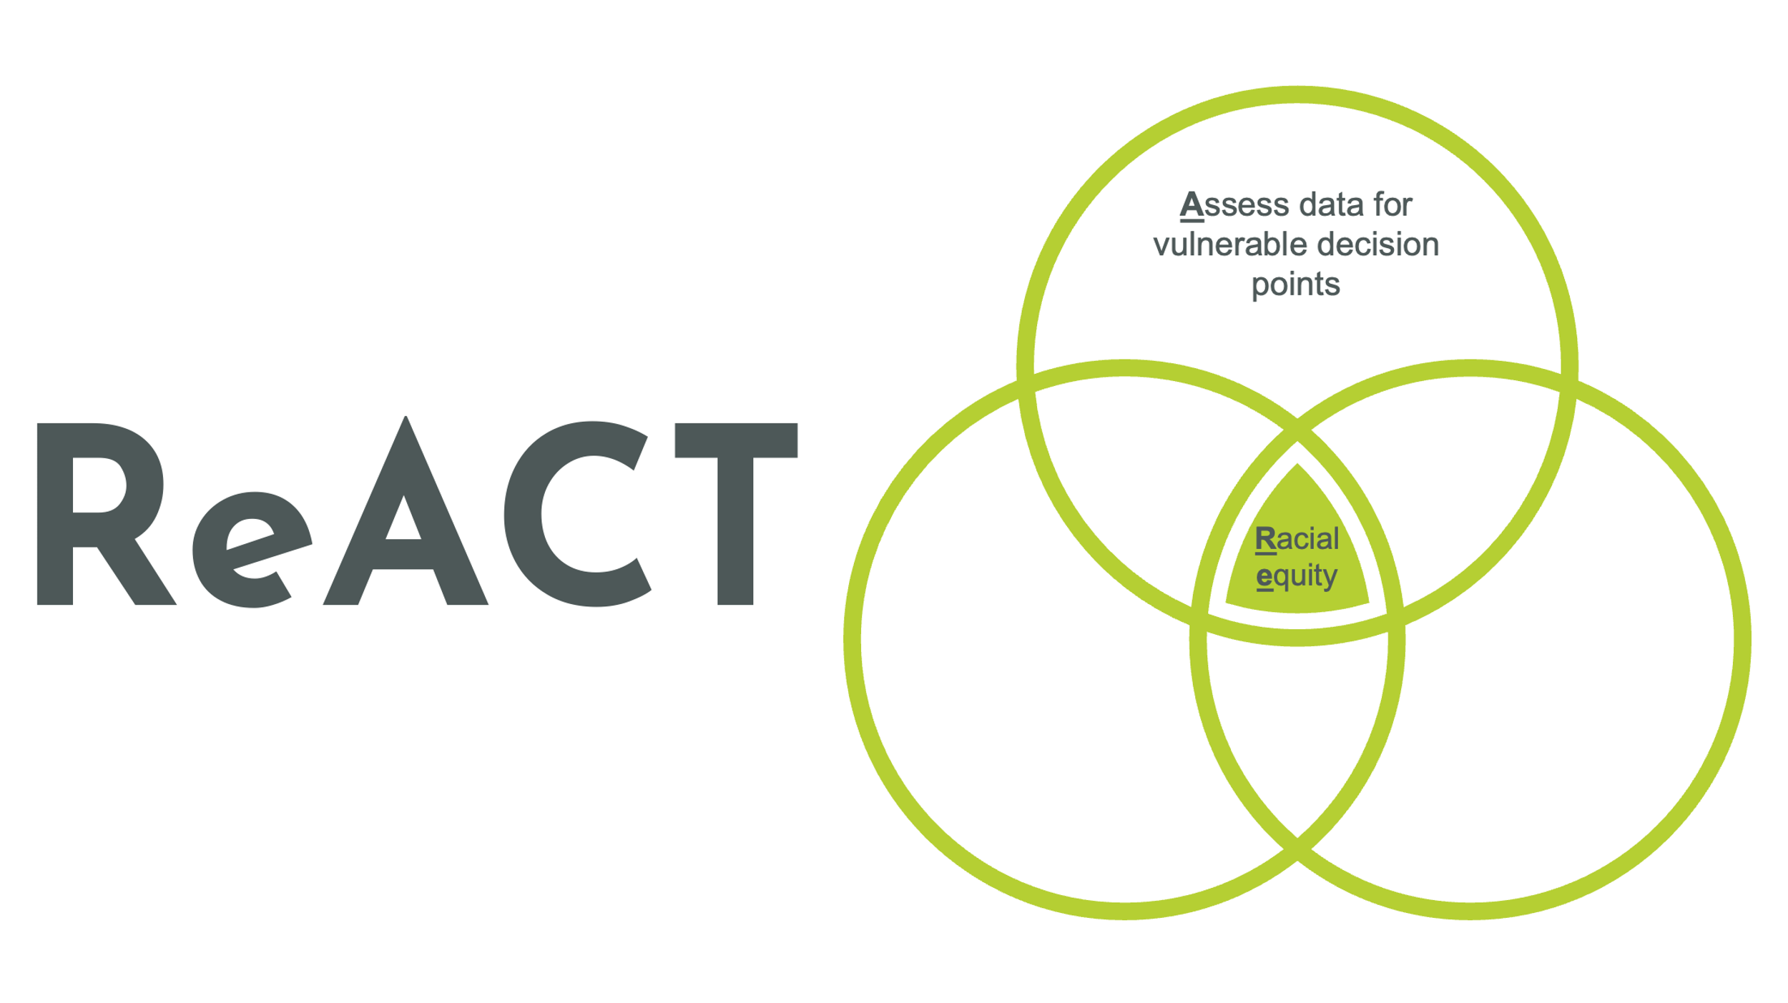
ReACT: Component A

Slide 24
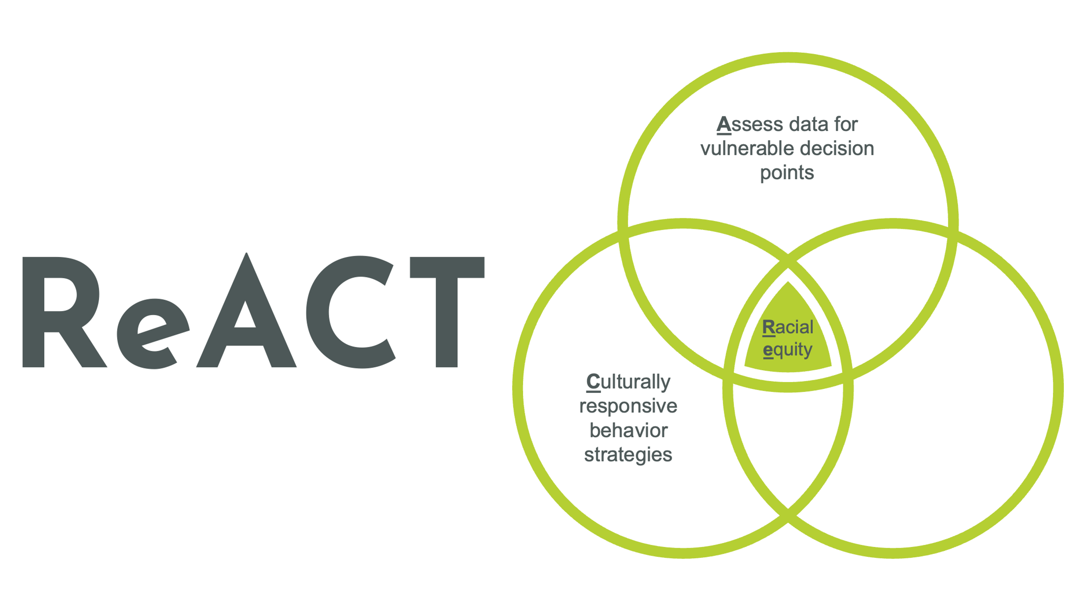
ReACT: Component C

Slide 25
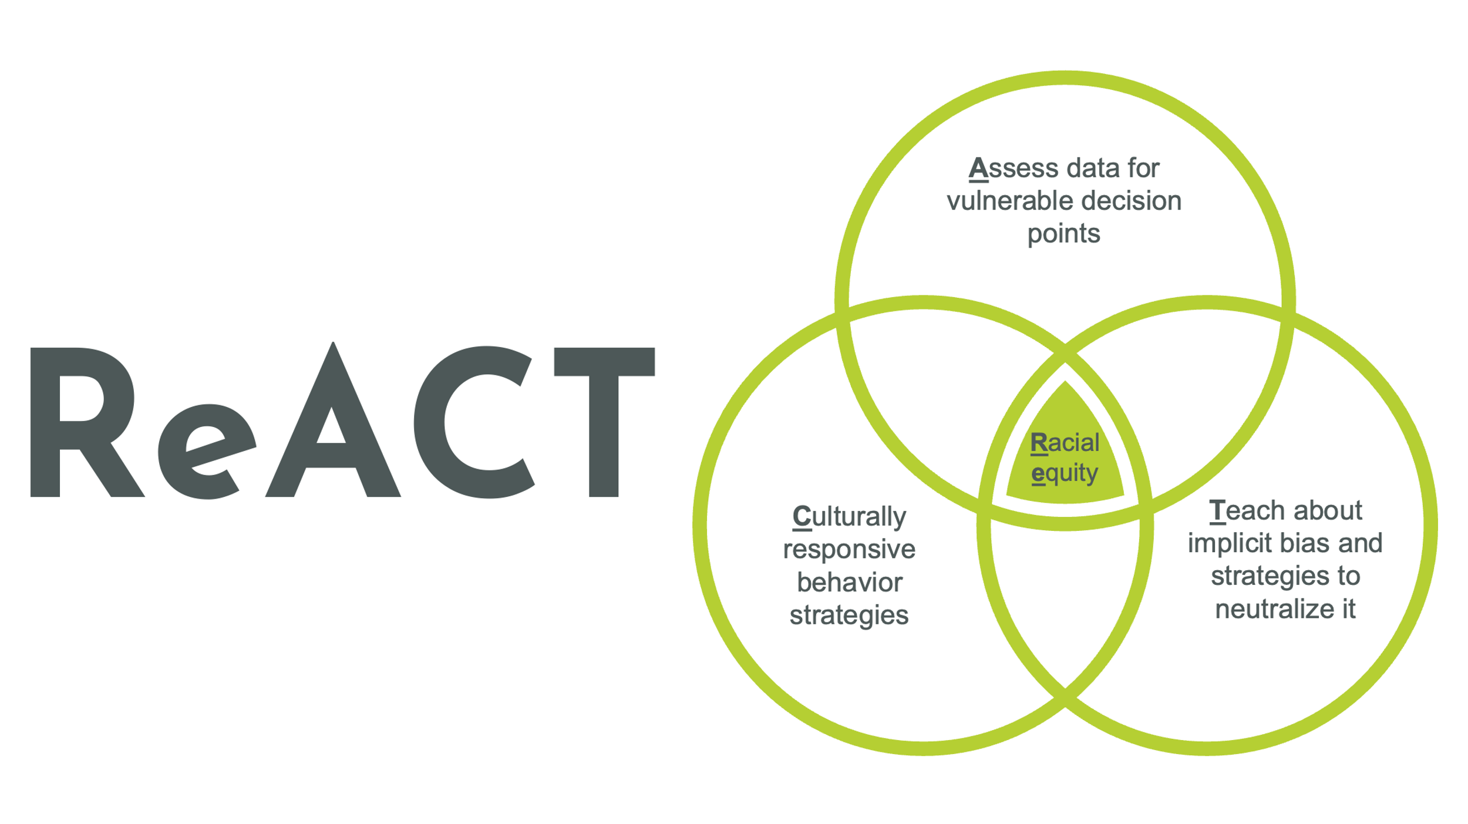
ReACT: Component T

Slide 26

Neutralizing Routine: Example
TRY
  Take a deep breath
  Reflect on your emotions
  Youth’s best interest
TRY for students
  Take three deep breaths
  Reflect on your feelings
  You got this!

Slide 27
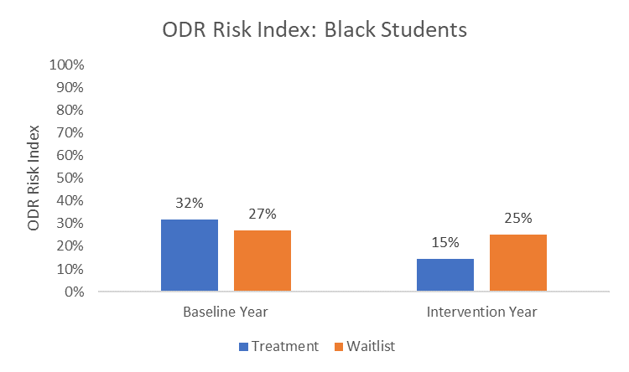
Equity-Centered PBIS RCT Outcomes: Black Students (McIntosh et al., 2021)
Notes:
Drop of 53%

Slide 28
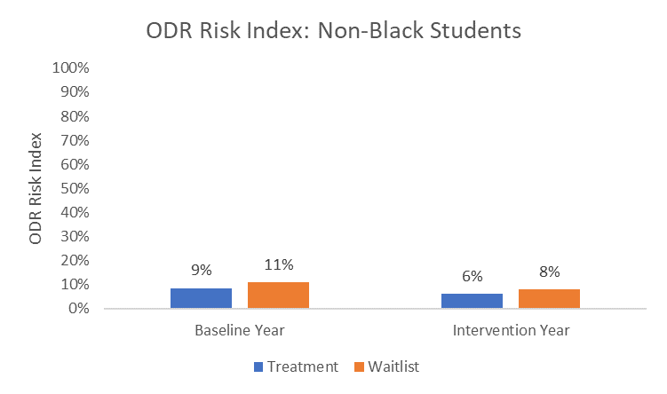
Equity-Centered PBIS RCT Outcomes: Non-Black Students (McIntosh et al., 2021)
Notes:
Drop of 33% for non-Black students

Slide 29
Big Ideas and Resources
3
Implement district and state systems with the goal of improving classroom practices.
  https://www.pbis.org/resource/pbis-implementation-blueprint
Utilize MTSS to integrate social-emotional-behavioral well-being and mental health practices.
  https://www.pbis.org/mental-health-social-emotional-well-being
  https://www.pbis.org/resource/integrating-a-trauma-informed-approach-within-a-pbis-framework
Provide educators with concrete strategies to create equitable spaces of belonging.
  https://www.pbis.org/equity
  https://www.pbis.org/resource/pbis-cultural-responsiveness-field-guide-resources-for-trainers-and-coaches

Slide 30

Key Take Away Message
SEB and mental health are critical to student success, both at school and beyond.
Intentionally creating educational spaces that are able to provide safe, predictable, and responsive learning environments is necessary for effective academic instruction to exist.

Slide 31

Discussing
What actionable next steps will enhance SEB support through MTSS?
  Where are there natural opportunities to blend PBIS and SEL initiatives?
  How can we more intentionally center equity and belonging in the framework?
:
Scan to access MTSS resources to support your discussion
Notes:
Overview of core features related to topic
Share data to frame the conversation
Big idea(s) about needed actions to inform
Policy,
Research, and/or
TA
Resources to inform next actionably steps for policy, research, and/or TA
Take away message
Big question to frame the table conversation

