Slide 1
MTSS-A: How do we support students’ academic needs in an MTSS framework?
MTSS Forum | December 10, 2024
Erica Lembke & Lana Santoro
lembkee@missouri.edu lles@bu.edu

Slide 2
Framing
Core Features
EBPs, Fidelity, Differentiation
Data to Inform Discussion
Elements of Data-Based Decision Making (DBDM)
Big Ideas and Resources
What we know; Where are the gaps?
1
2
3
Notes:
Overview of core features related to topic
Share data to frame the conversation
Big idea(s) about needed actions to inform
Policy,
Research, and/or
TA
Resources to inform next actionably steps for policy, research, and/or TA
Take away message
Big question to frame the table conversation

Slide 3
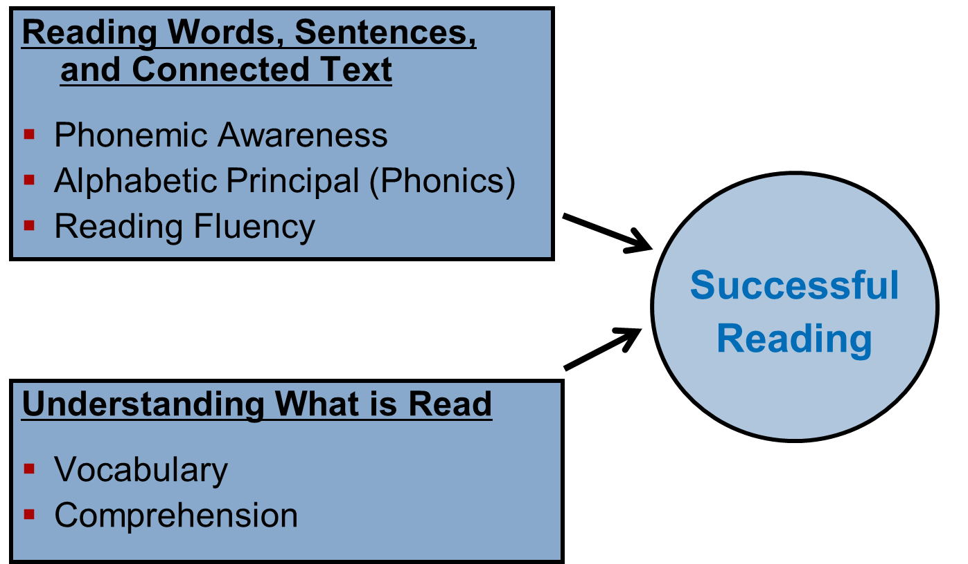
Core Features—What we know about EBPs
1
Evidence Based Practices
What to Teach: Instructional Design
Big Ideas
How to Teach: Instructional Delivery
Conspicuous (Explicit) Instruction
Scaffolded Instruction
Opportunities to Practice with Corrective Feedback

Slide 4
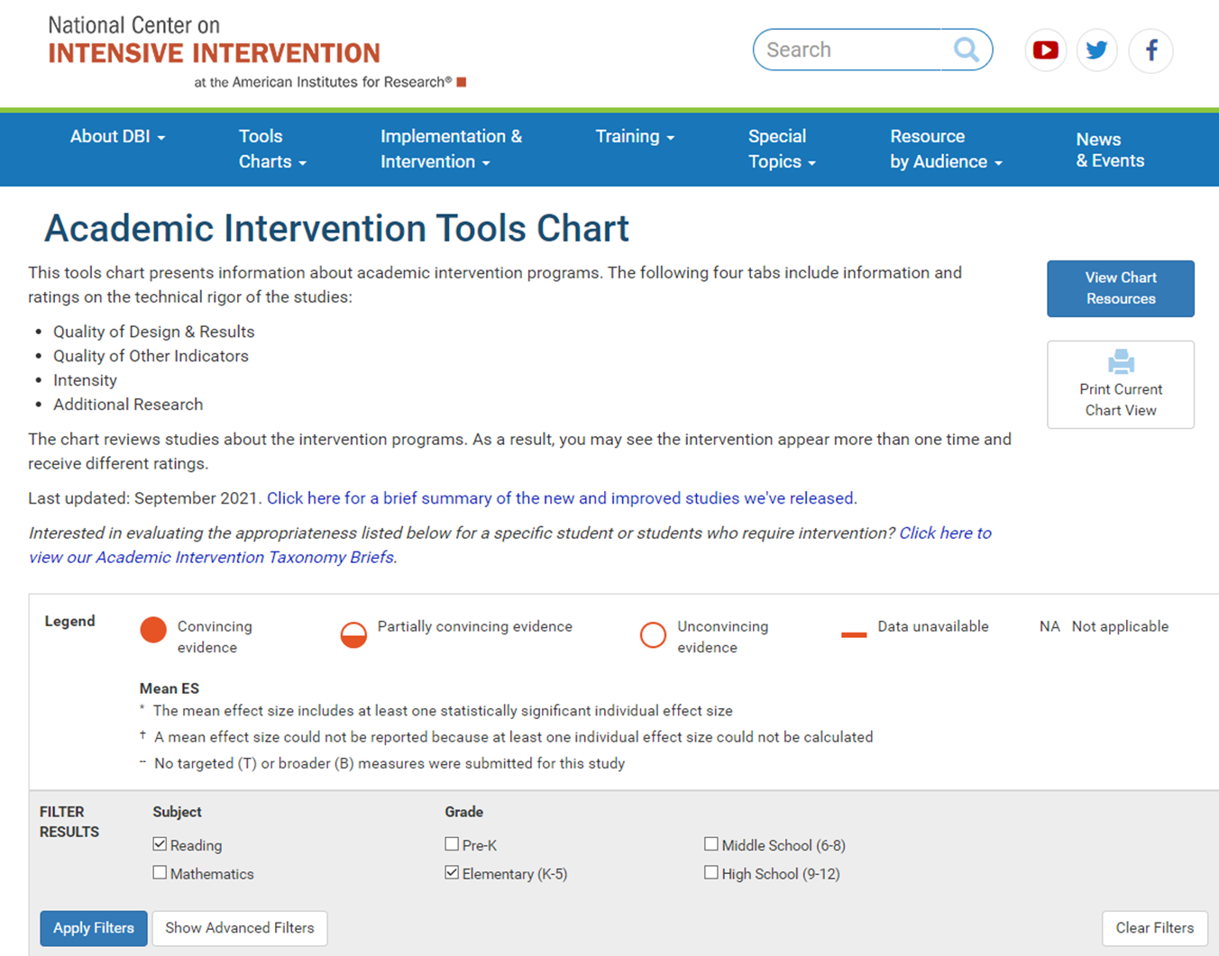
Core Features—Find EBPs
1
Evidence Based Practices
https://ies.ed.gov/ncee/wwc/practiceguides
https://intensiveintervention.org

Slide 5
Core Features—Fidelity
1
Fidelity (see Lembke, et al. 2024)
Three key factors: (1) adherence to the prescribed intervention, (2) exposure or the frequency and duration of the intervention, and (3) the quality of how well the intervention was delivered (Sanetti & Kratochwill, 2009)
Research findings indicate that when implemented with fidelity, interventions show average effect sizes that are two to three times greater than when fidelity is not monitored (Durlak & DuPre, 2008)
Fidelity is vital for identifying whether a student requires more intensive support and forms the foundation for the DBI process (Lemons et al., 2014).

Slide 6
Core Features—Importance of Fidelity
1
Fidelity
Reporting of fidelity in research is increasing (Sanetti et al., 2020)
It’s critically important to highlight fidelity to readers because of the strength of intervention that can be fully realized when implemented as intended
Given that the fidelity of implementation of a validated intervention program serves as the foundation of the DBI process and promotes the generalizability of an intervention, it is imperative to have fidelity checks integrated into the process (McMaster et al., 2020)

Slide 7
Core Features—Differentiation
1
Differentiation
Instruction that takes into account children’s individual differences generally leads to stronger student literacy, math, and cognitive regulation (e.g., attention, effortful control) outcomes.
https://www.readingrockets.org/videos/classroom/carol-mcdonald-connor-tier-1-differentiation

Slide 8
Core Features—Continuum of Intensification
1
Differentiation – Continuum of Intensification
Tier I
Tier II
Tier III
Whole group/small group instruction-CORE
At-Risk Readers:
Core-aligned small group instruction for strategic intervention
Significantly below grade level/not responding to HQ Tier 1/2:
Core-aligned small group for intensified intervention
ALL Students:
Prioritized content and teaching routines; high quality instruction
Scaffold as needed (Fast track is an option)
Possible shift to intensification materials
Tier 2 +
Tier 3 - Light

Slide 9
Data to Inform Discussion—DBDM
2
Data-Based Decision Making—High Leverage Practice #6
Use student assessment data, analyze instructional practices, and make necessary adjustments that improve student outcomes.

Slide 10
Data to Inform Discussion—DBI
2
Data-Based Decision Making—
National Center on Intensive Intervention Data Based Individualization (DBI) model
Which aspects are most difficult for teachers?

Slide 11
Big Ideas and Resources (1)
3
Where are the gaps (in academic MTSS)? How are these being addressed?
Universal curriculum and meeting all students’ needs
Difficult for those who have the most expertise in MTSS (typically those in special education and school psychology) to influence change in terms of general education curriculum
Big $$ for publishing companies to sell what schools want. And what they want isn’t always best for kids.

Slide 12
Big Ideas and Resources (2)
3
Where are the gaps (in academic MTSS)? How are these being addressed?
Universal curriculum and meeting all students’ needs
Need to continue to have strong partnerships with school leaders
Establish partnerships and provide support and training for leaders when they are receiving their preparation at the university

Slide 13
Big Ideas and Resources (3)
3
Where are the gaps (in academic MTSS)? How are these being addressed?
Defining Tier 3
What we Know:
Academic instruction should align with learner needs
Strategies to support cognitive processes (e.g., self-regulation and memory) should be integrated
Instruction should be differentiated by making it more explicit and systematic and by increasing opportunities for feedback
Instructional time should be increased
Group size should be reduced
What We Still Need to Learn:
How to teach reading effectively to children with severe reading difficulties and disabilities.
Since publication of the IES Practice Guide on struggling readers and MTSS-R, only a handful of Tier 3 intervention studies have been published.
(Vaughn, Wanzek, Murray, & Roberts; 2012)

Slide 14
Big Ideas and Resources (4)
3
Where are the gaps (in academic MTSS)? How are these being addressed?
Defining Tier 3
Tier 3 intensification is a process that requires. . .
Thoughtful strategic integration of content with carefully juxtaposed and sequenced instructional routines within and across lessons.
Instruction designed and delivered with density.
Mastery monitoring.

Slide 15
Big Ideas and Resources (5)
3
Where are the gaps (in academic MTSS)? How are these being addressed?
Integration of behavior and academics and mental health
What We Know:
Mental health supports can be integrated into academic skills instruction
For example:
Project Grow (Al Otaiba et al., SMU)
Strong Students Toolbox (Grills, Vaughn, et al., University of Texas-Austin)
Application of the Strong Students Toolbox to Teacher Read Alouds (Grills, Santoro, Markham-Anderson, et al., Boston University)

Slide 16
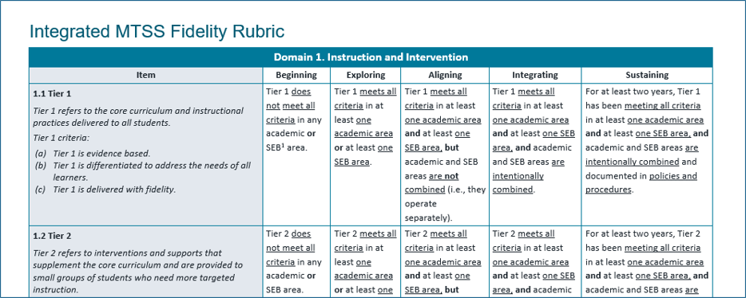
Big Ideas and Resources (6)
3
Where are the gaps (in academic MTSS)? How are these being addressed?
--integration of academics and behavior, American Institutes for Research and University of Missouri

Slide 17
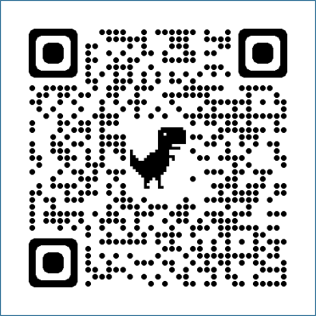
Big Ideas and Resources (7)
3
Where are the gaps (in academic MTSS)? How are these being addressed?
--integration of academics and behavior
https://www.air.org/resource/guidetoolkit/integrated-mtss-fidelity-rubric-imfr

Slide 18
Big Ideas and Resources (8)
3
Where are the gaps (in academic MTSS)? How are these being addressed?
Integration of behavior and academics and mental health
What We Still Need to Learn:
The degree, nature, and level of strategic integration
For example:
Strategic integration of emotional skills and literacy skills within vocabulary and comprehension instruction.
(Santoro & Smith, in press)

Slide 19
Big Ideas and Resources (9)
3
Where are the gaps (in academic MTSS)? How are these being addressed?
Need for better structures at Middle and High School
Systems for progress monitoring
Data Utilization
Interventions and/or strategies
Professional Development or Coaching to enhance practices of novice or alt cert teachers

Slide 20
Big Ideas and Resources (10)
3
Where are the gaps (in academic MTSS)? How are these being addressed?
Need for better structures at Middle and High School
One example, Project STAIR (Supporting Teaching of Algebra: Individual Readiness; Powell, Lembke, et al., 2021)
Overview and materials: https://www.smu.edu/simmons/research/research-in-mathematics-education/explore/stairr
Brief videos of EBPs in mathematics: https://www.youtube.com/channel/UCE2puwDtUSNXFONIOhmYmvA

Slide 21
Key Take Away Message
There is a need to look more broadly at MTSS in terms of integration—across areas and systems.

Slide 22
Discussing
How do different technical assistance providers collaborate?
How do we apply the idea of integration at all levels of the system? Including a student who has integrated needs? Motivation, academic, etc. Support students, teachers, schools at all levels?
Other thoughts you might have related to specific needs
:
Scan to access MTSS resources to support your discussion
Notes:
Overview of core features related to topic
Share data to frame the conversation
Big idea(s) about needed actions to inform
Policy,
Research, and/or
TA
Resources to inform next actionably steps for policy, research, and/or TA
Take away message
Big question to frame the table conversation

