Slide 1
Promise of MTSS:
What do we know and still need to learn from MTSS research?
MTSS Forum | December 10, 2024
Brandi Simonsen, Ph.D.
brandi.simonsen@uconn.edu

Slide 2


Framing
  Core Features
  Defining Integrated MTSS
  Data to Inform Discussion
  Emerging Research on I-MTSS
  Big Ideas and Resources
  Sharing I-MTSS Resources
1
0
2
  Brief Detour
  History of MTSS
3
Notes:
Overview of core features related to topic
Share data to frame the conversation
Big idea(s) about needed actions to inform
Policy,
Research, and/or
TA
Resources to inform next actionably steps for policy, research, and/or TA
Take away message
Big question to frame the table conversation

Slide 3
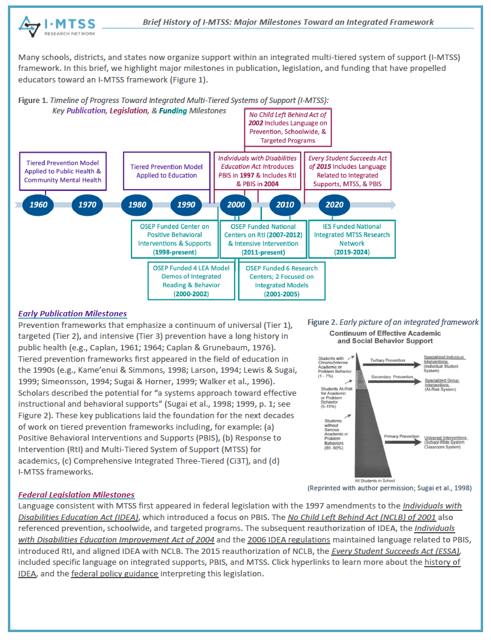
Timeline of Progress Toward Integrated Multi-Tiered Systems of Support:
Key Publication, Legislation, & Funding Milestones
No Child Left Behind Act of 2002 Includes Language on Prevention, Schoolwide, & Targeted Programs
Tiered Prevention Model Applied to Public Health & Community Mental Health
Tiered Prevention Model Applied to Education
Individuals with Disabilities Education Act Introduces PBIS in 1997 & Includes RtI & PBIS in 2004
Every Student Succeeds Act of 2015 Includes Language Related to Integrated Supports, MTSS, & PBIS
1960
1970
1980
1990
2000
2010
2020
OSEP Funded Center on Positive Behavioral Interventions & Supports
(1998-present)
OSEP Funded National Centers on RtI (2007-2012)
& Intensive Intervention
(2011-present)
IES Funded National Integrated MTSS Research Network
(2019-2024)
OSEP Funded 4 LEA Model Demos of Integrated Reading & Behavior
(2000-2002)
OSEP Funded 6 Research Centers; 2 Focused on Integrated Models
(2001-2005)
Notes:
Confirm whether RtI center focused K-12
OSEP Funded 4 LEA models (elementary focused)
Decision rule:
-explicitly talks about multi-tiered framework or lays foundation;
-ground-breaking wtih consensus among early leaders in the field
NCLB: PL 107-110
ESSA: PL 114-95 Section 8101 [20 U.S.C. 7801] Part A--Definitions “(33) MULTI-TIER SYSTEM OF SUPPORTS.—The term ‘‘multi- tier system of supports’’ means a comprehensive continuum of evidence-based, systemic practices to support a rapid response to students’ needs, with regular observation to facilitate data- based instructional decisionmaking. ”
Add legislation to this timeline as well -- PL94-142 (1975) and original IDEA and IDEA (2004) / Ed Improvement Act (1997)
Missing from timeline: OSEP LD Summit circa 1999-2000. Book included writings that set foundation for RTI and inclusion in IDEA 2004
Missing: OSEP SPDG funding priority, which included requirements for PD on MTSS
Add Ci3T (1996) and ISF (2016)
Add CSEFEL, TACSEI, & Pyramid (see notes below table)
Is there a misalignment between policy and practice (ESEA, IDEA -. Tiered systems is not a gen ed or sped thing. Predominatly sped researcher knowledge and theory generated
https://sites.ed.gov/idea/IDEA-History#1975

Slide 4
Framing: focus on core features
  Core Features
  Defining Integrated MTSS
  Data to Inform Discussion
  Emerging Research on I-MTSS
  Big Ideas and Resources
  Sharing I-MTSS Resources
1
Notes:
Overview of core features related to topic
Share data to frame the conversation
Big idea(s) about needed actions to inform
Policy,
Research, and/or
TA
Resources to inform next actionably steps for policy, research, and/or TA
Take away message
Big question to frame the table conversation

Slide 5
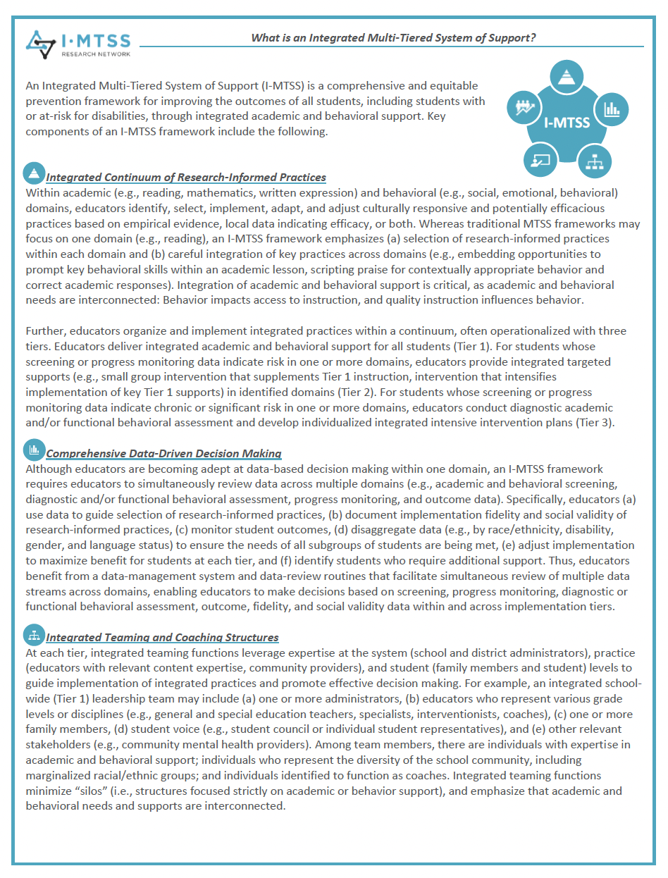
Core Features: Defining Integrated MTSS
1
An Integrated Multi-Tiered System of Support (I-MTSS)
is a comprehensive prevention framework for improving students’ academic (e.g., reading, math) and behavioral (e.g., social, emotional, behavioral, mental health) outcomes.

Slide 6





Core Features: Key Components of I-MTSS
1
Integrated Continuum of Research-Informed Practices
Comprehensive Data-Driven Decision Making
Integrated Teaming and Coaching Structures
Integrated Professional Development
Additional Systems to Support Sustained and Scaled Implementation

Slide 7
Graphic of Integrated MTSS
Intensive
Intensive
Targeted
Targeted
Universal
Universal
Academic Support
Behavior Support

Slide 8
Quadrants of Integrated MTSS
Intensive
Academic Support
Intensive
Behavior Support
Targeted
Academic Support
Targeted
Behavior Support
Universal
Academic Support
Universal
Behavior Support
Academic Support
Behavior Support

Slide 9
Quadrants of Integrated MTSS with Details
Universal Academic +
Intensive Behavior
Integrated
Intensive Academic +
Intensive Behavior
Universal Academic +
Targeted Behavior
Integrated
Targeted Academic +
Targeted Behavior
Academic Support
Integrated
Universal Academic +
Universal Behavior
Universal Behavior +
Targeted Academic
Universal Behavior + Intensive Academic
Behavior Support

Slide 10
Framing: focus on data to inform discussion
  Core Features
  Defining Integrated MTSS
  Data to Inform Discussion
  Emerging Research on I-MTSS
  Big Ideas and Resources
  Sharing I-MTSS Resources
1
2
3
Notes:
Overview of core features related to topic
Share data to frame the conversation
Big idea(s) about needed actions to inform
Policy,
Research, and/or
TA
Resources to inform next actionably steps for policy, research, and/or TA
Take away message
Big question to frame the table conversation

Slide 11
Data to Inform Discussion: Emerging Research
2
Prevalence of MTSS
Promise of I-MTSS
Past research on I-MTSS
Current research of the I-MTSS Research Network

Slide 12
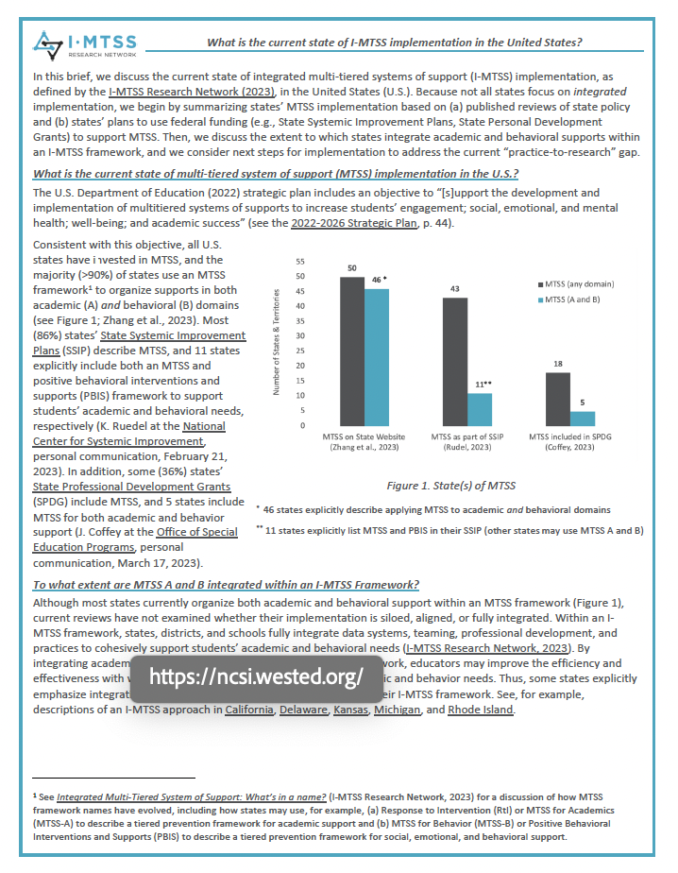
States of I-MTSS Implementation
“all U.S. states have invested in MTSS, and the majority (>90%) of states use an MTSS framework to organize supports in both academic (A) and behavioral (B) domains”

Slide 13
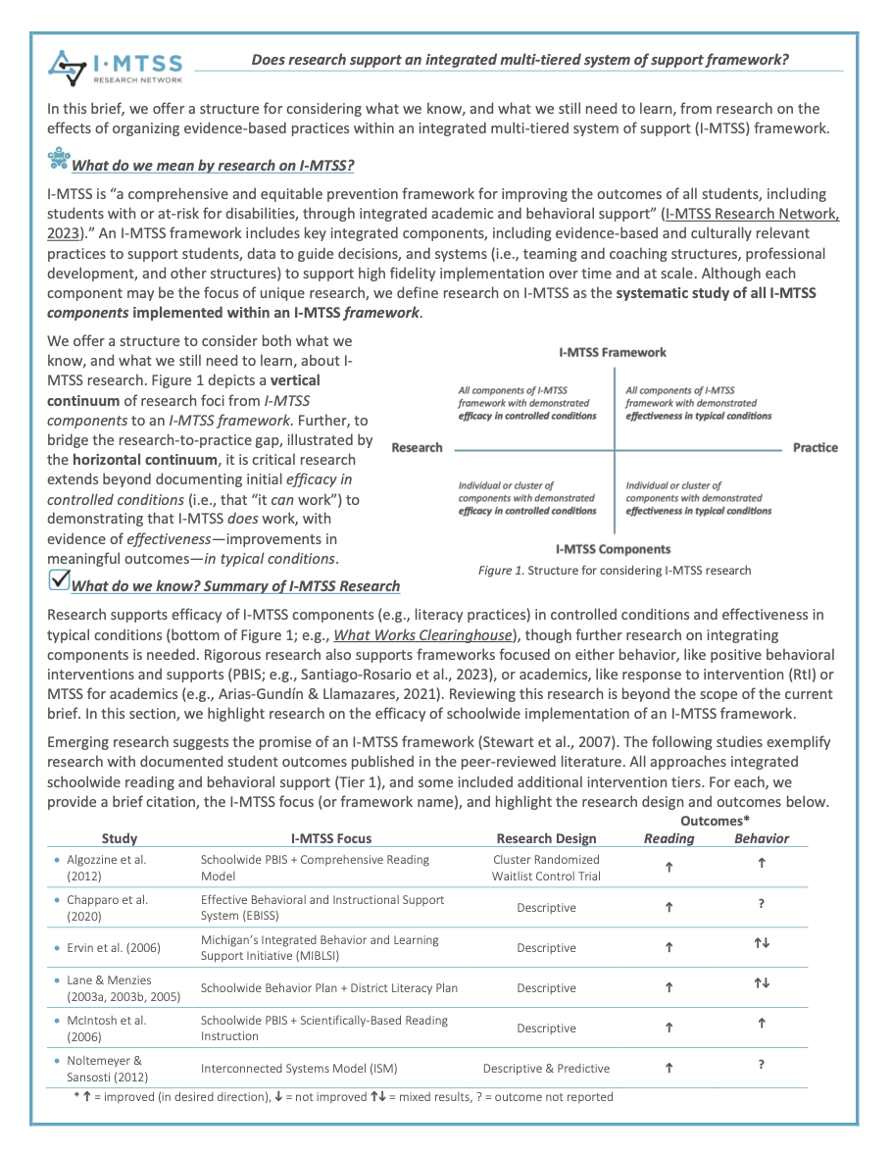
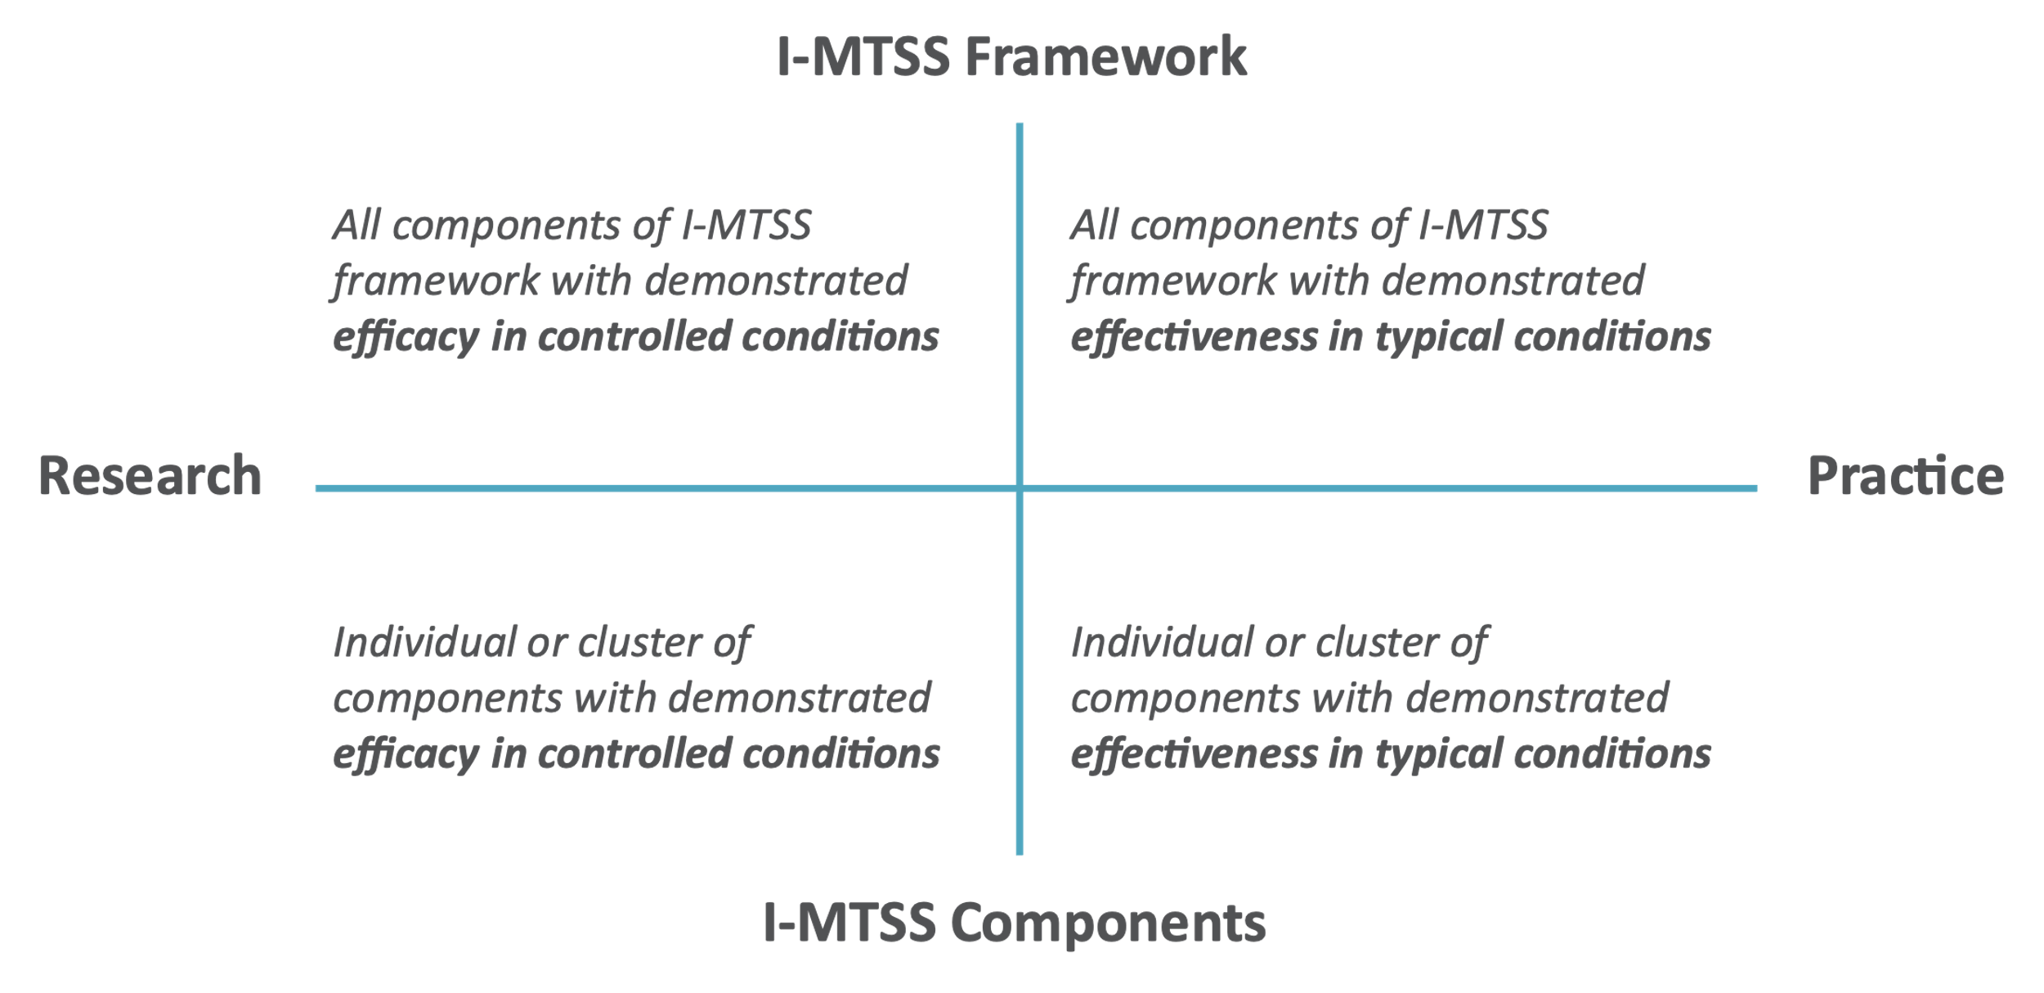
Past Research on I-MTSS
MTSS Brief hyperlinked: https://mtss.org/wp-content/uploads/2024/02/Does-Research-Support-I-MTSS-2024.pdf
Credit: Steve Goodman
Notes:
https://mtss.org/wp-content/uploads/2024/02/Does-Research-Support-I-MTSS-2024.pdf

Slide 14

Studies of I-MTSS
Outcomes*
Study | I-MTSS Focus | Research Design | Reading | Behavior
Algozzine et al. (2012) | Schoolwide PBIS + Comprehensive Reading Model | Cluster Randomized Waitlist Control Trial | h | h
Chaparro et al. (2020) | Effective Behavioral and Instructional Support System (EBISS) | Descriptive | h | ?
Ervin et al. (2006) | Michigan’s Integrated Behavior and Learning Support Initiative (MIBLSI) | Descriptive | h | hi
Lane & Menzies (2003a, 2003b, 2005) | Schoolwide Behavior Plan + District Literacy Plan | Descriptive | h | hi
McIntosh et al. (2006) | Schoolwide PBIS + Scientifically-Based Reading Instruction | Descriptive | h | h
Noltemeyer & Sansosti (2012) | Interconnected Systems Model (ISM) | Descriptive & Predictive | h | ?
* h = improved (in desired direction), i = not improved hi = mixed results, ? = not reported
Fewer than 10 studies
2 show positive effects
in reading and behavior
Notes:
https://mtss.org/wp-content/uploads/2024/02/Does-Research-Support-I-MTSS-2024.pdf

Slide 15
Current Research of the I-MTSS Network
Credit: Steve Goodman
Notes:
https://mtss.org/wp-content/uploads/2024/02/Does-Research-Support-I-MTSS-2024.pdf

Slide 16
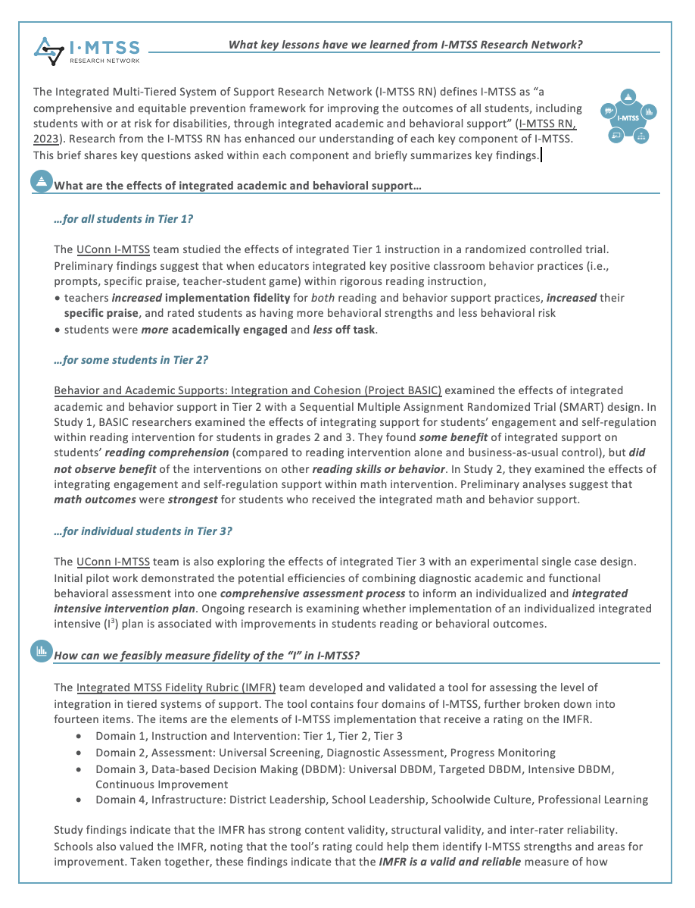


Lessons Learned from
I-MTSS Research Network
Integrated Research-Informed Practices may result in better outcomes for students across tiers
When educators integrated key positive classroom behavior practices within rigorous reading instruction in Tier 1:
Teachers
  ↑ implementation fidelity (for behavior AND reading)
  ↑ EBPs (e.g., specific praise)
Students
  ↑ behavioral strengths ↓behavioral risk
  ↑ academically engaged ↓ off task
*Based on preliminary data from Cohort 1

Slide 17


Lessons Learned from
I-MTSS Research Network (cont’d)
Integrated Research-Informed Practices may result in better outcomes for students across tiers
Integrated MTSS Fidelity Rubric (IMFR) shows promise as a reliable & valid measure of integrated implementation
Integrated Teams typically include an administrator, general & special education teachers, coaches, & specialists
Integrated Professional Development is desired to empower leaders, build school capacity, & systematically screen to inform instruction
Additional Systems to Support Sustained and Scaled Implementation require further study

Slide 18
Framing: focus on big ideas and resources
  Core Features
  Defining Integrated MTSS
  Data to Inform Discussion
  Emerging Research on I-MTSS
  Big Ideas and Resources
  Sharing I-MTSS Resources
1
2
3
Notes:
Overview of core features related to topic
Share data to frame the conversation
Big idea(s) about needed actions to inform
Policy,
Research, and/or
TA
Resources to inform next actionably steps for policy, research, and/or TA
Take away message
Big question to frame the table conversation

Slide 19
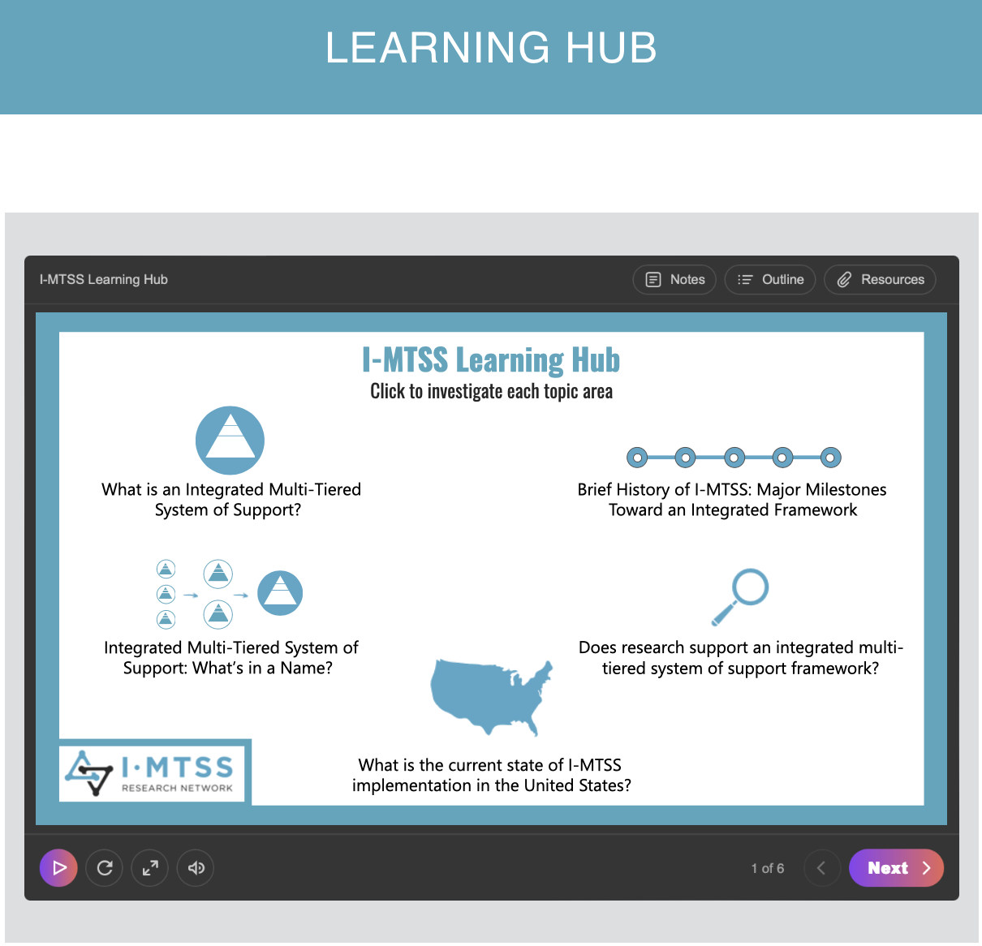
Big Ideas and Resources
Our new “learning hub” walks users through resources
3
MTSS is….
…a widely implemented…
…comprehensive prevention framework…
…that may improve efficiency & efficacy of EPBs;
…however, more research is critically needed to document the effectiveness of I-MTSS across contexts.

Slide 20

Key Take Away Message
MTSS is a a widely implemented comprehensive prevention framework that may improve efficiency and efficacy of EPBs; however, more research is critically needed to document the effectiveness of I-MTSS across contexts.

Slide 21

Discussing
Discussing
What actionable next steps will contribute to growing the knowledge base for MTSS?
:
Scan to access MTSS resources to support your discussion
Notes:
Overview of core features related to topic
Share data to frame the conversation
Big idea(s) about needed actions to inform
Policy,
Research, and/or
TA
Resources to inform next actionably steps for policy, research, and/or TA
Take away message
Big question to frame the table conversation

